Slide 1


ADVANCED DATA MINING AND ANALYTICS
Efficient Underwriting
By: Alfred, Dev, Harika & Nick

Slide 2
WHAT ARE WE TRYING TO DO?
Making a decision whether to accept or deny a loan application based on several parameters to maximize the revenue generated, keeping in mind the maximum funds available to give out in loans.

Slide 3
Group 2
Presentation Outline
1.Exploratory Analysis
2.Modelling Technique
3.Insights
4.Results
5.Projections

Slide 4
EXPLORATORY ANALYSIS

Slide 5
LET'S CRUNCH SOME NUMBERS FOR SCENARIO 1 & 2
Total number of customers: 25,471
Total loan requested: $1,269,776,911
Maximum loan amount requested: $89,995
Minimum loan amount requested: $10,002
Proposed interest rate: 4.32%
Missing values in the training data: 593,281

Slide 6
LET'S CRUNCH SOME NUMBERS FOR SCENARIO 3
Total number of customers: 25,471
Total loan requested: $1,280,654,185
Maximum loan amount requested: $89,993
Minimum loan amount requested: $10,003
Average proposed interest rate: 4.292058%
Lowest proposed interest rate: 1%
Highest proposed interest rate: 7.6%
Missing values in the training data: 593,281

Slide 7
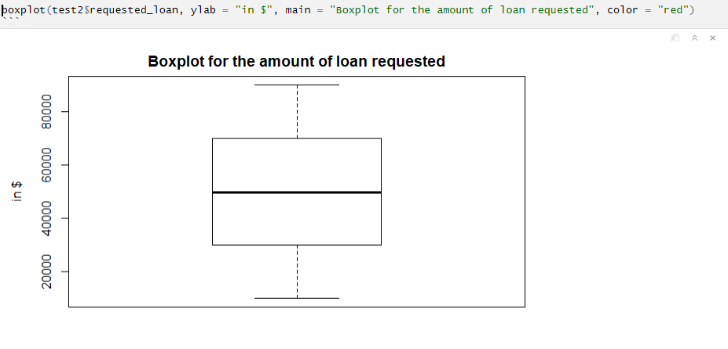

Slide 8
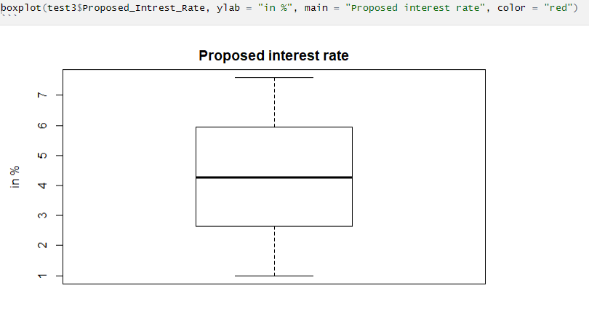

Slide 9
MODELLING TECHNIQUE

Slide 10
So, what algorithms did we use?
XGBOOST
PRINCIPLE COMPONENT ANALYSIS

Slide 11
INSIGHTS
SCENARIO 1 & 2
- Loan applications accepted: 3,352
- Loan applications denied: 22,119
- Amount of loan disbursed: $ 164,442,425
- Expected gain: $ 577,543,556
- Expected loss: $ 418,737,602
- Net return: $ 158,805,953

Slide 12
INSIGHTS
SCENARIO 3
- Loan applications accepted: 3,574
- Loan applications denied: 21,897
- Amount of loan disbursed: $ 178,139,206
- Expected gain: $ 629,582,495
- Expected loss: $ 466,037,645
- Net return: $ 163,544,849

Slide 13
RESULTS

Slide 14
HOW MANY LOAN APPLICATIONS WERE ACCEPTED?
13.1%
OF TOTAL LOAN APPLICATIONS WERE ACCEPTED FOR SCENARIO 1 & 2
16.3%
OF TOTAL LOAN APPLICATIONS WERE ACCEPTED FOR SCENARIO 3

Slide 15

PROJECTIONS
FOR ALL SCENARIOS COMBINED
NET RETURN
LOAN APPLICATIONS ACCEPTED
$ 322,350,802
6,926
LOAN AMOUNT DISBURSED
$ 342,581,631

